Slide 1
Anchor-free Ranging-Likelihood-based
ARLCL
Cooperative Localization
Dimitris Xenakis
15/08/2021, BENEFRI Summer School 2021

Slide 2
Anchor-free Ranging-Likelihood-based Cooperative Localization
Outline
Introduction (Recap since last year)
Background, Motivation & Current Solution
Proposed Methodology
Creating the required Ranging-Likelihood model
How to perform positioning using ARLCL
Assessing ARLCL
Results

Slide 3
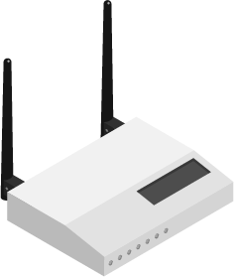
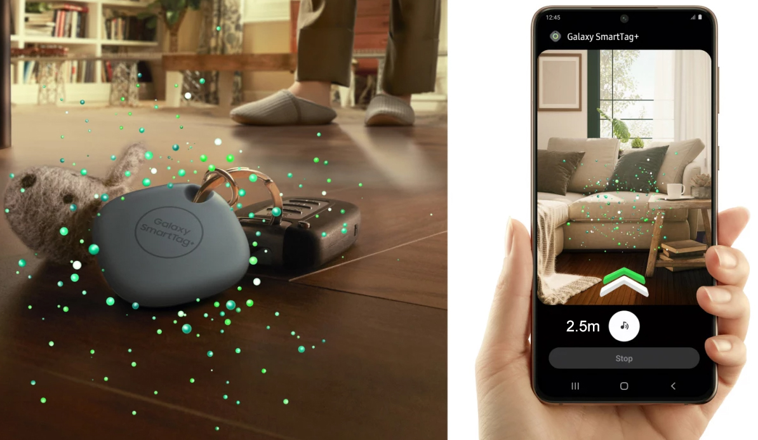
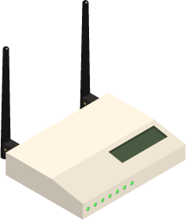
Anchor-free Ranging-Likelihood-based Cooperative Localization
Introduction
Motivation
The more signals, the better
Yet, no effective node cooperation
Recent advances and opportunities
(Samsung Ad for Galaxy S21 Ultra)
Indoor Positioning System
with multiple Nodes
Range Estimation

Slide 4
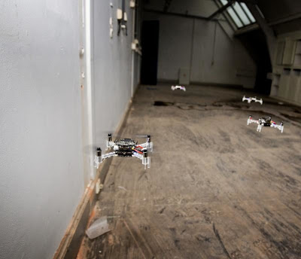
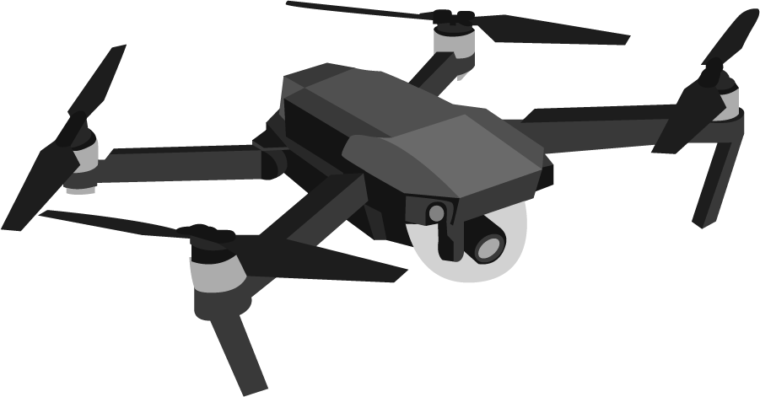
Anchor-free Ranging-Likelihood-based Cooperative Localization
Introduction
Various applications
More information available
→ Higher positioning accuracy
Facilitates limited to No-Infrastructure positioning
→ Anchor Free localization
(where position estimations have arbitrary origin)
* Simultaneous Localization And Mapping
Covid Tracking
Cooperative SLAM using UAV’s
*
Indoor Positioning System
with multiple Nodes
Range Estimation

Slide 5
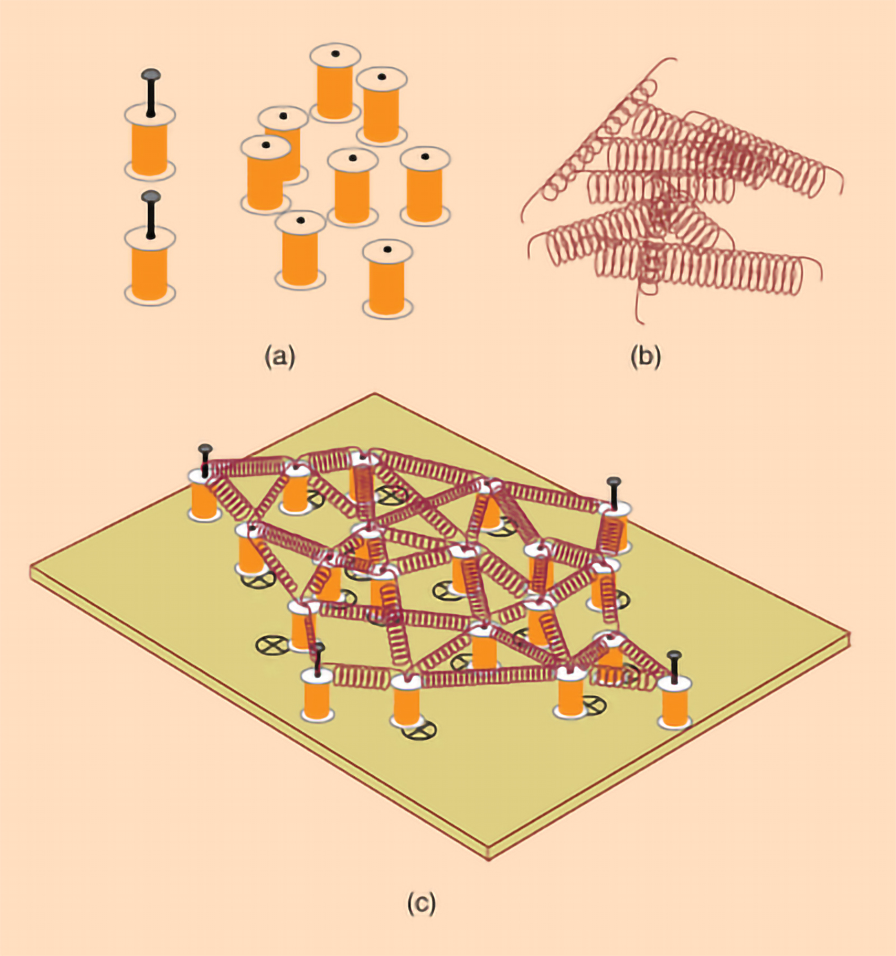
Anchor-free Ranging-Likelihood-based Cooperative Localization
Introduction
Anchor-free Ranging-based Cooperative Localization (ARLCL) today
Mass-Spring Localization
$$a_{1}$$
$$a_{2}$$
$$d_{a_{1}a_{2} }$$
$Unknown position of agent a_{i}$ at Pos($x_{i}$, $y_{i}$)
$$d_{a_{1}a_{3} }$$
$Distance estimation d_{a_{i}a_{j} }based on noisy measurements$
$$d_{a_{2}a_{3} }$$
$$a_{3}$$
→ Non-Linear Optimization problem
Minimize the energy to reach equilibrium
But.. are all measurements equally important?
Estimations of far distances → more uncertainty
Spring energies typically defined using Hooke’s law
- We need to model this uncertainty.

Slide 6
Anchor-free Ranging-Likelihood-based Cooperative Localization
Ranging likelihood as a requirement for ARLCL
A function to describe P(Distance; Measurement)
ARLCL utilizes iteratively the Density Function PMeasurement(distance) to assign proper importance
Method is technology-agnostic
(WiFi ranging, Ultrasonic ranging, BLE ranging, etc..)
.. Given that Node-A received from Node-B this measurement,
how likely is that Node-B is 5m far?

Slide 7
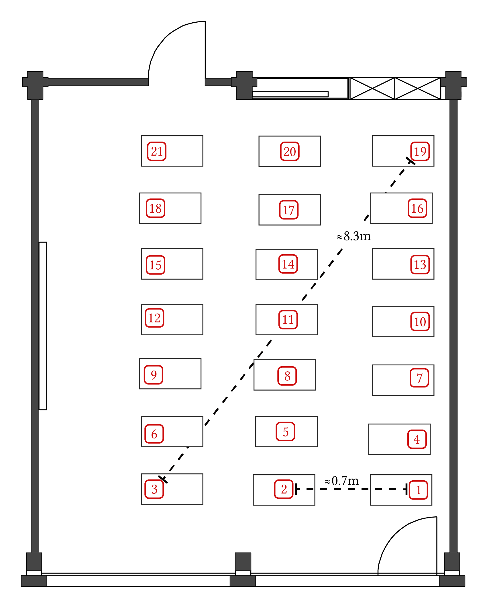
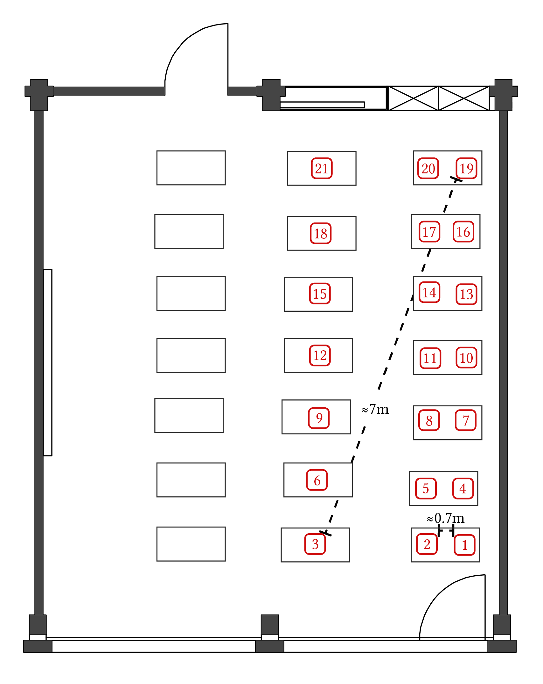
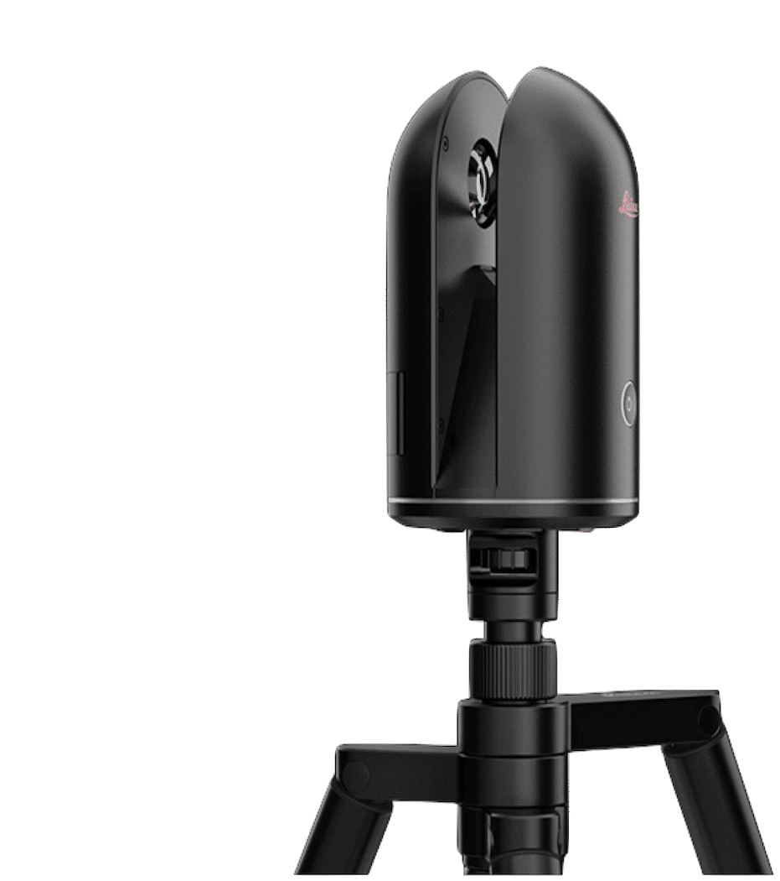
Anchor-free Ranging-Likelihood-based Cooperative Localization
Modelling the ranging likelihood
Sampling process
Collect Received Signal Strength (RSS) measurements between all pairs of 21 BLE-Enabled Raspberries (RPi’s)
True Positions recorded with LiDAR Scanner (Leica BLK360)
x2 deployment shapes (Sparse & Thin/Dense)
x10 times (@random RPi’s orientations)
x 5mins
Sparse
Thin/Dense

Slide 8
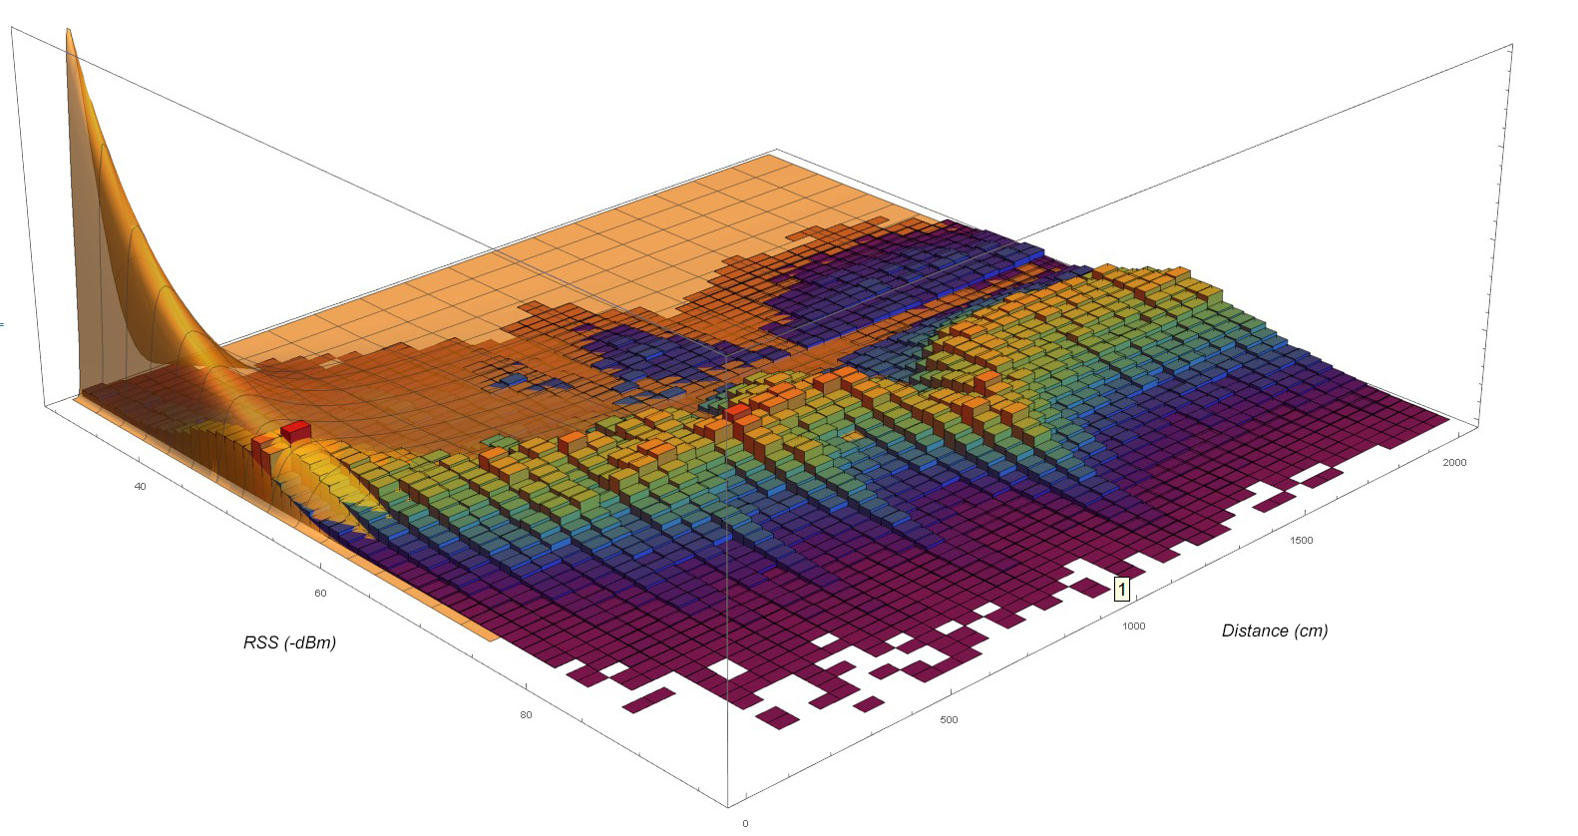
From Frequency Histogram to Final Model
Anchor-free Ranging-Likelihood-based Cooperative Localization
Modelling the ranging likelihood
Strong
Long
$RSS$ (-dBm)
$Distance$ (cm)
Weak
Short

Slide 9
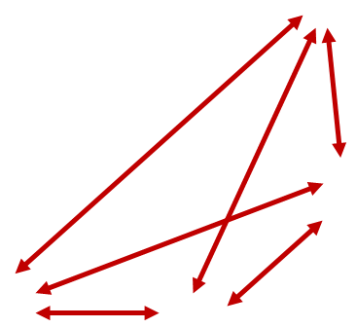
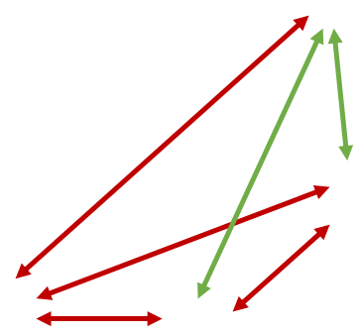
The methodology outline
Anchor-free Ranging-Likelihood-based Cooperative Localization
Performing swarm positioning with ARLCL
Init
Place the Nodes (i.e. the Swarm) randomly on space
Cycle
Select the 1st Node (according to some selection order) to correct his position
Select all Neighbor Nodes that have effective measurements towards that Node
Get each measurement’s PDF and rotate it (according to the modelled DoF)
360°
Find the global max of the product of these PDFs and move the 1st Node to that position
Proceed with the 2nd Node and continue until the last one.
>> Repeat cycle until we converge..

Slide 10
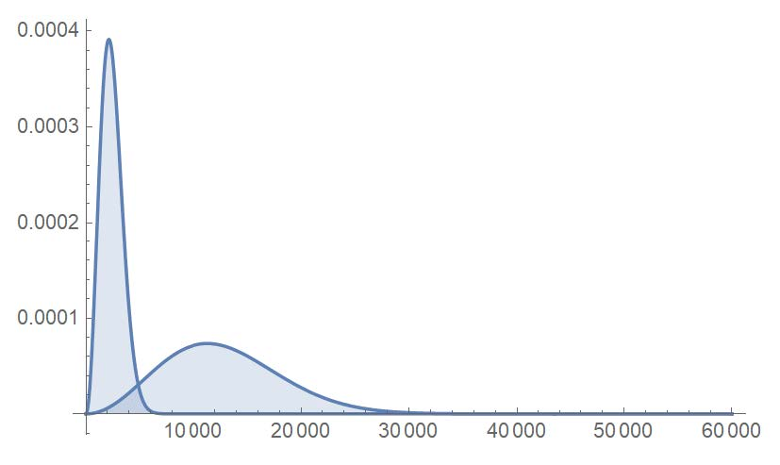
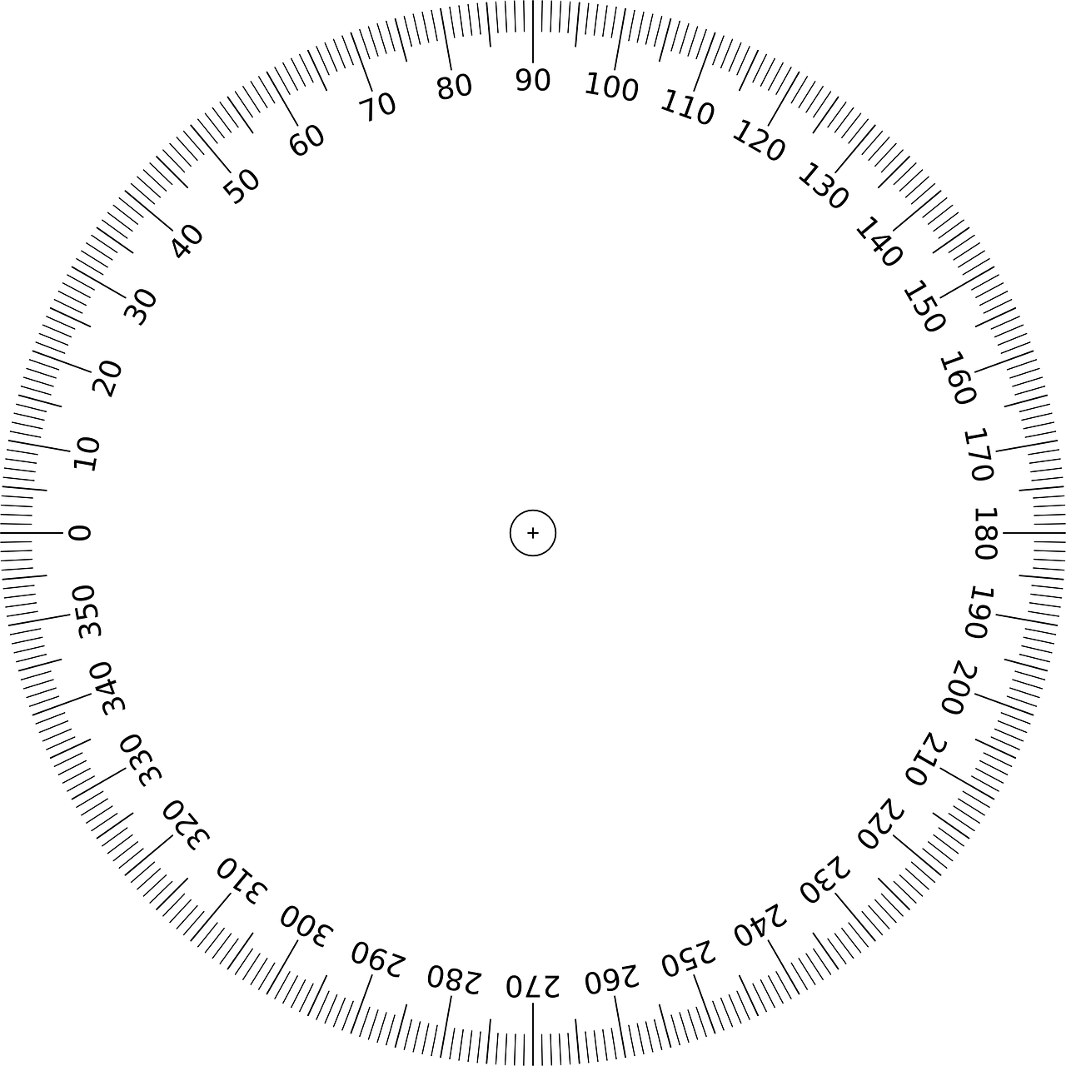
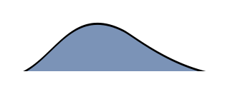
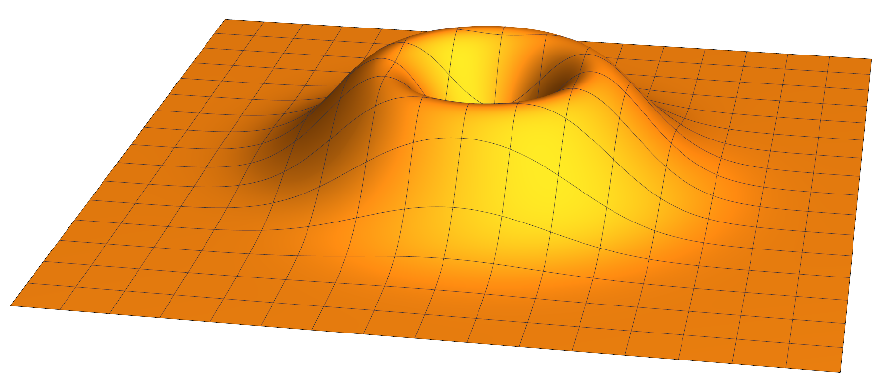
Rotating the Position’s PDF
Anchor-free Ranging-Likelihood-based Cooperative Localization
Performing swarm positioning with ARLCL
$$Strong RSS$$
- Get the P$\left(x_{c} ;RSS\right)$ that corresponds to some measurement
Current Node Pos($x_{c}$) lies on this axis
$$Weak RSS$$
${Neighbor}_{i}$
Pos($x_{i}$, $y_{i}$)
${Neighbor}_{i}$ Pos($x_{i}$)
- We expand considering 2-Dimensions → i.e. go from Pos($x_{c}$) to Pos($x_{c}$, $y_{c}$)
- Replace $x$ in P$\left(x_{c} ;RSS\right)$ with the eq. $\sqrt{{(x_{i}−x_{c})}^{2}+{(y_{i}−y_{c})}^{2}}$
$${Neighbor}_{i}$$
$Cur. Node$

Slide 11
Compare against Mass Spring Method
Anchor-free Ranging-Likelihood-based Cooperative Localization
Assessing ARLCL
Using our developed Ranging Model and True positions of the 21 RPi’s..
Get a noisy RSS measurement between each pair
Evaluated variables
- Swarm shape x2 $(Sparse, Thin/Dense)$
- Swarm size x19 $(3.. 21)$
- Noise level x20 $(1.. 20)$ (PDF resamplings to get an average RSS)
Repetition parameters
- Position initialization x100 $(1..100)$ (Random initial node placement)
- Node Combinations x200
= ~14m Evaluated cases

Slide 12
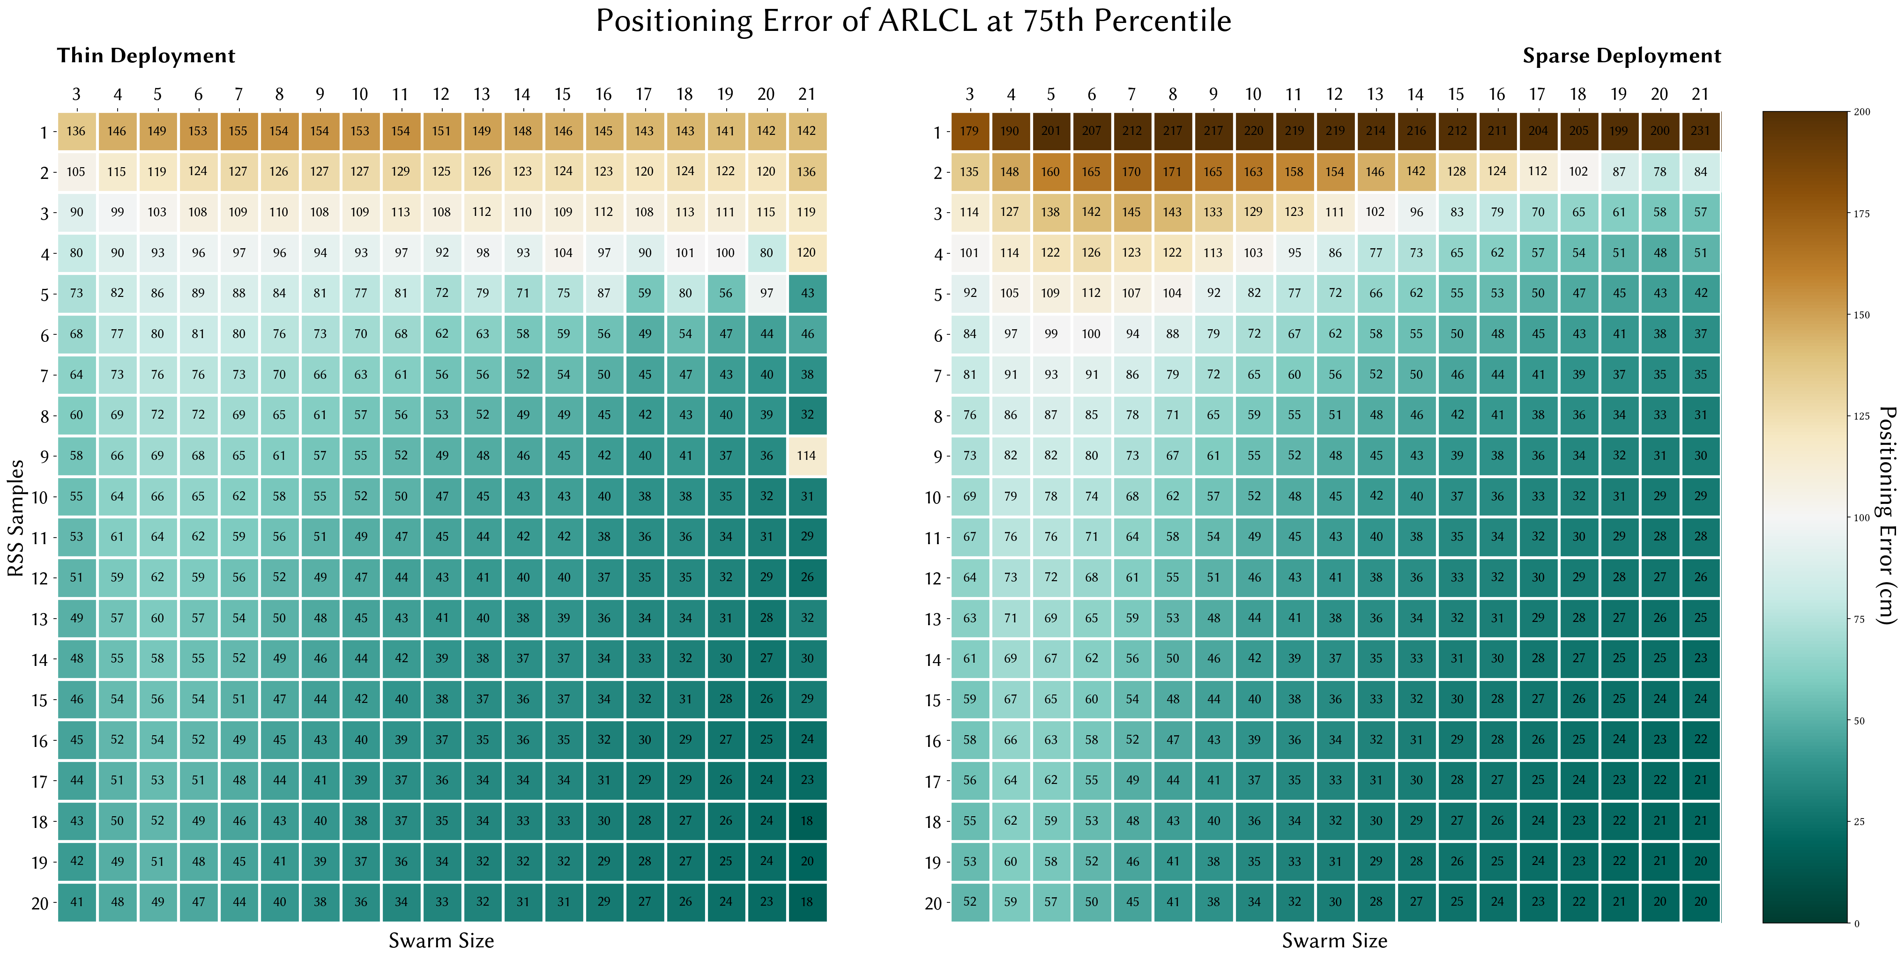
Positioning Error of ARLCL at 75th Percentile
Anchor-free Ranging-Likelihood-based Cooperative Localization
Results

Slide 13
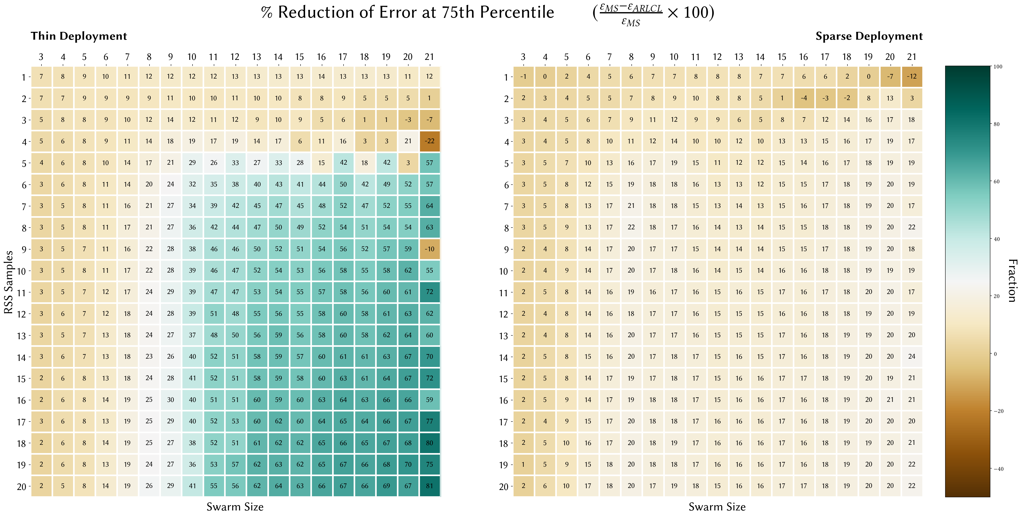
% Reduction of Error at 75th Percentile (EMS -EARLCL)/EMS x100
Anchor-free Ranging-Likelihood-based Cooperative Localization
Results

Slide 14
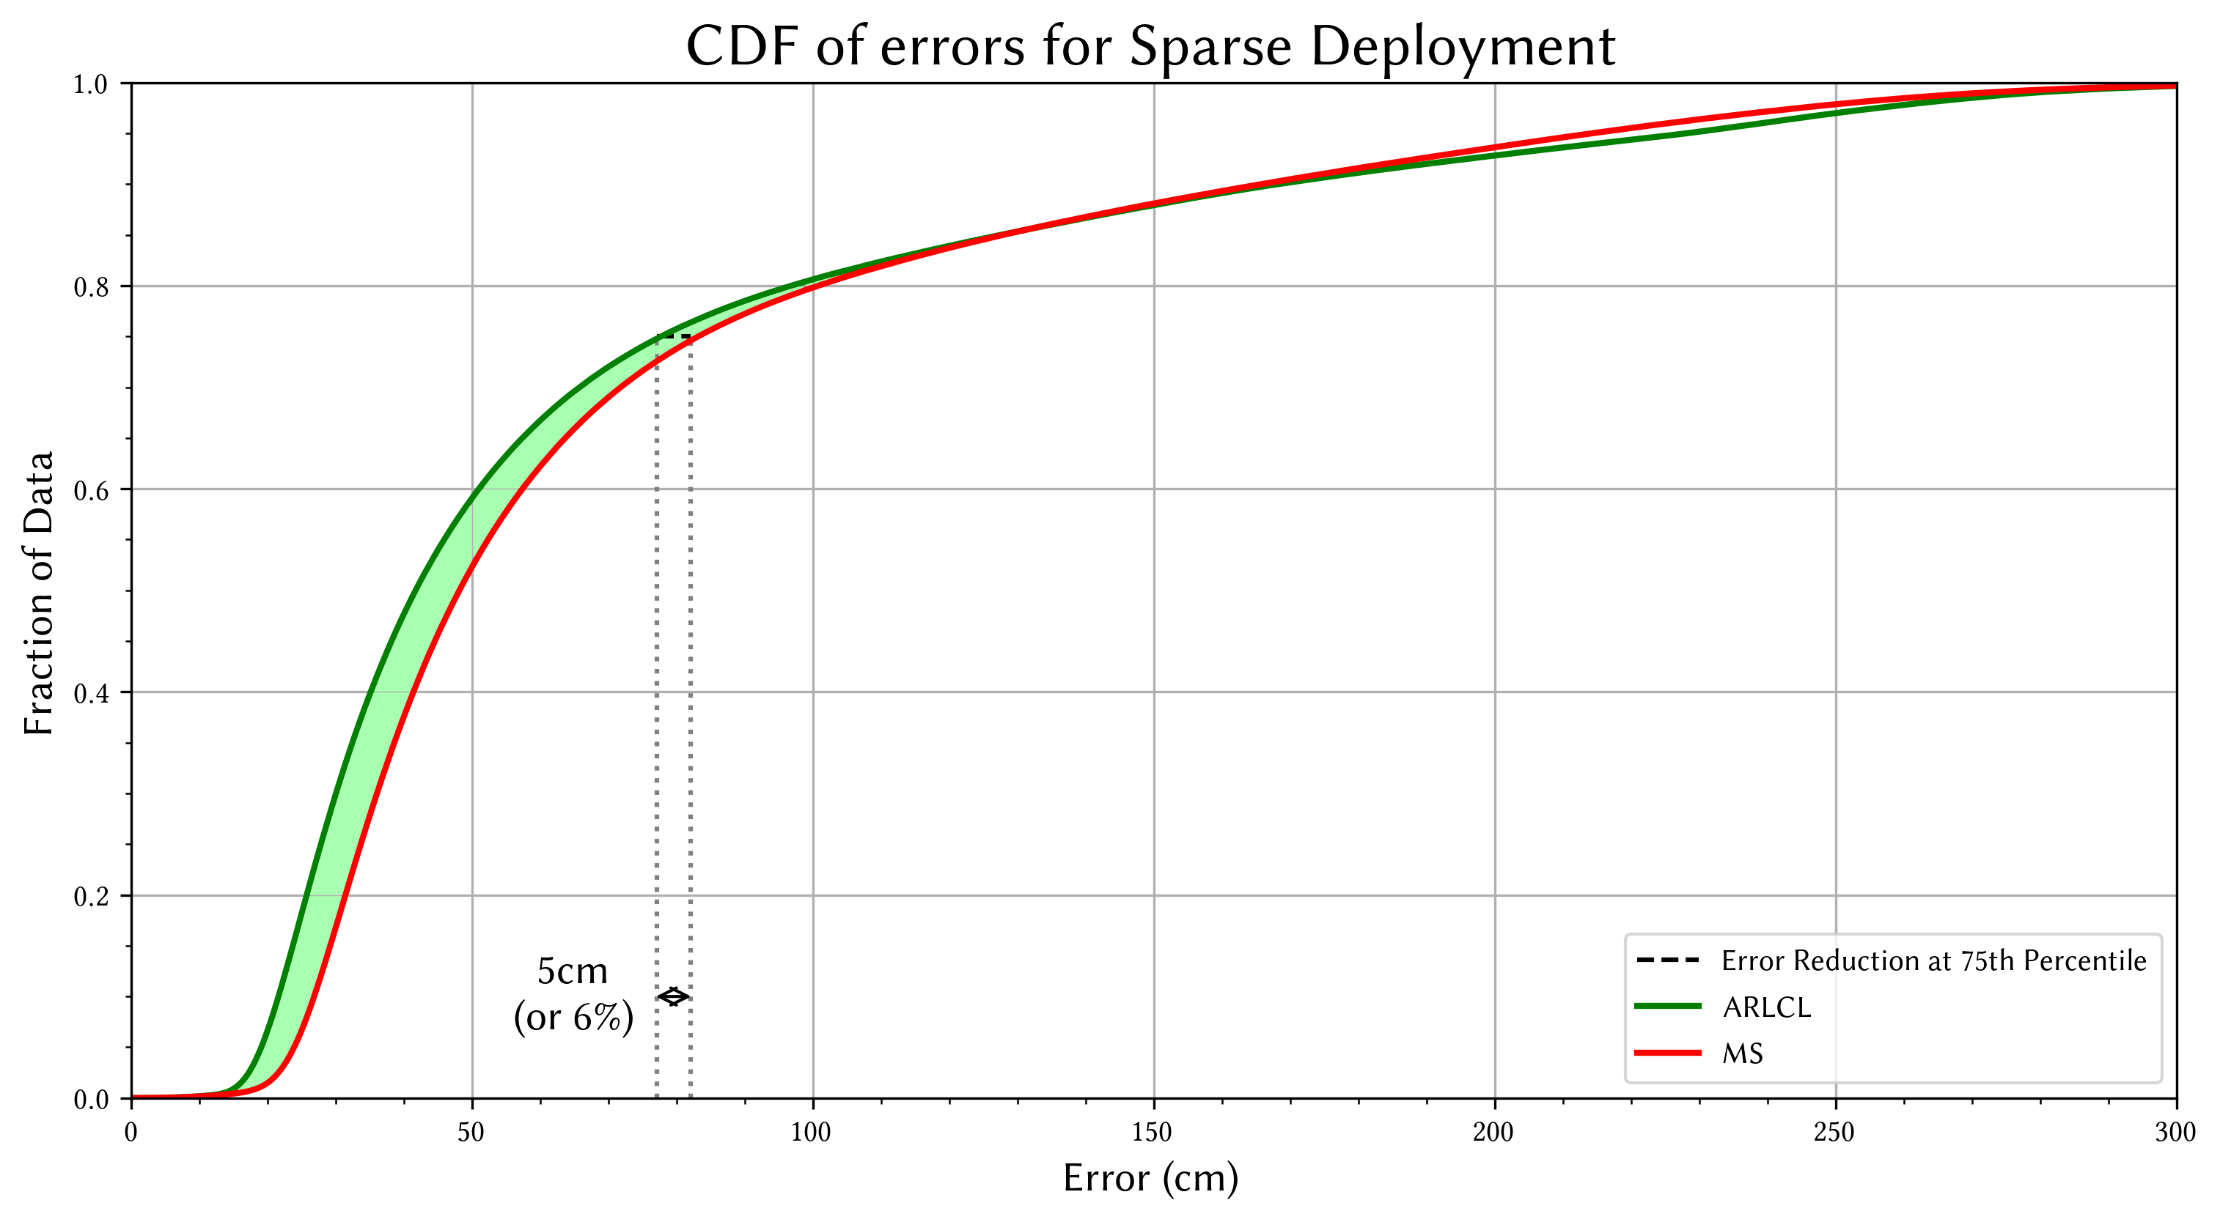
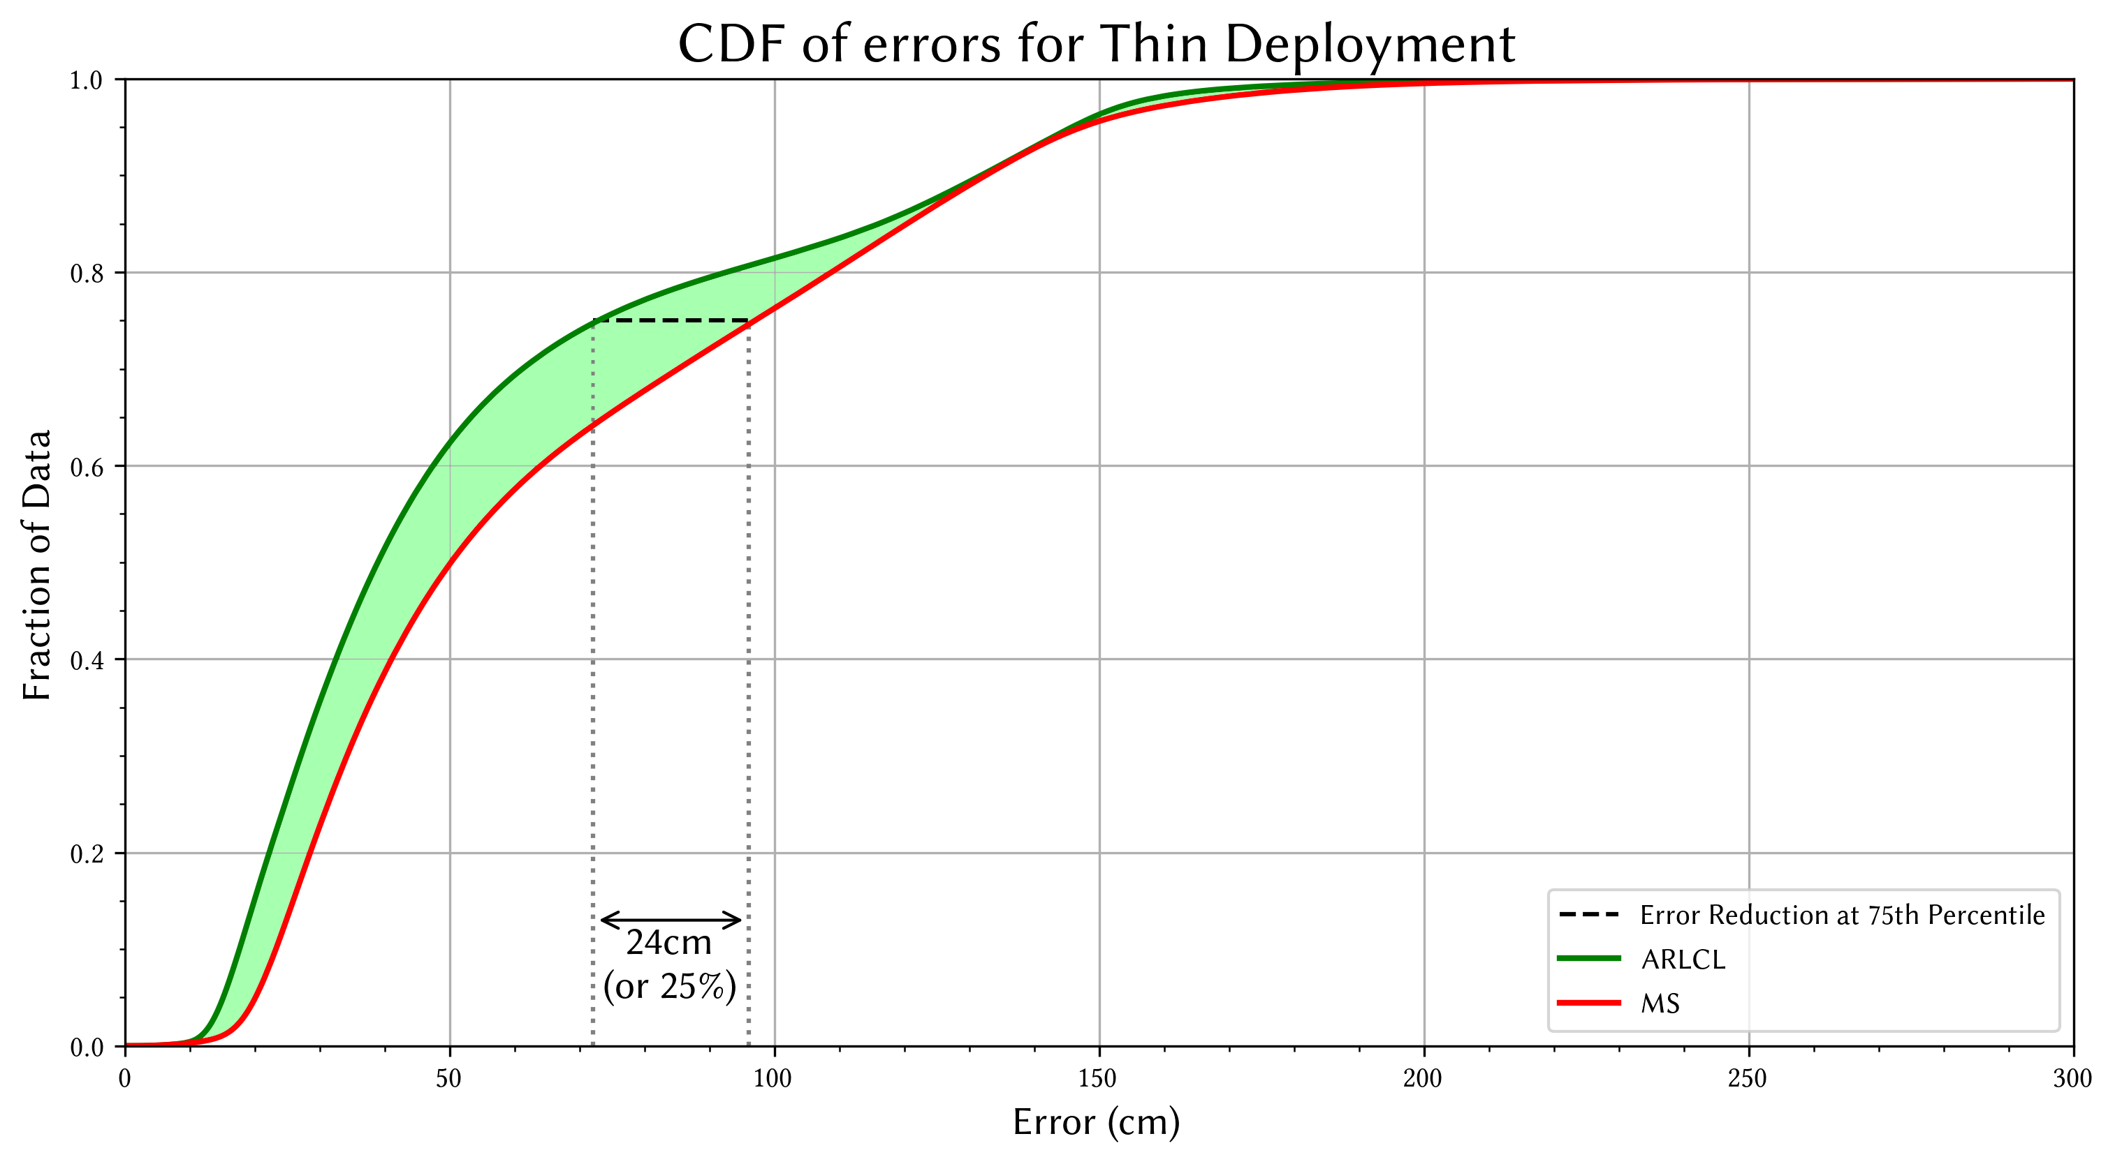
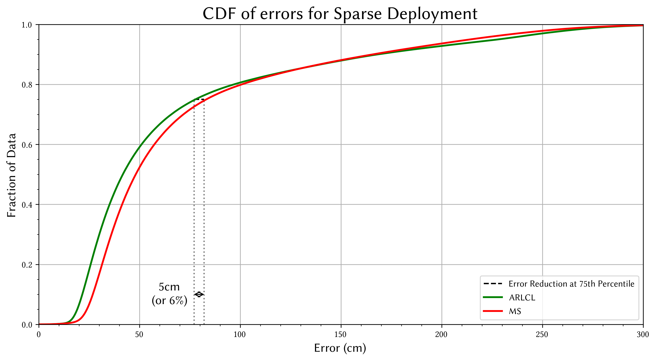
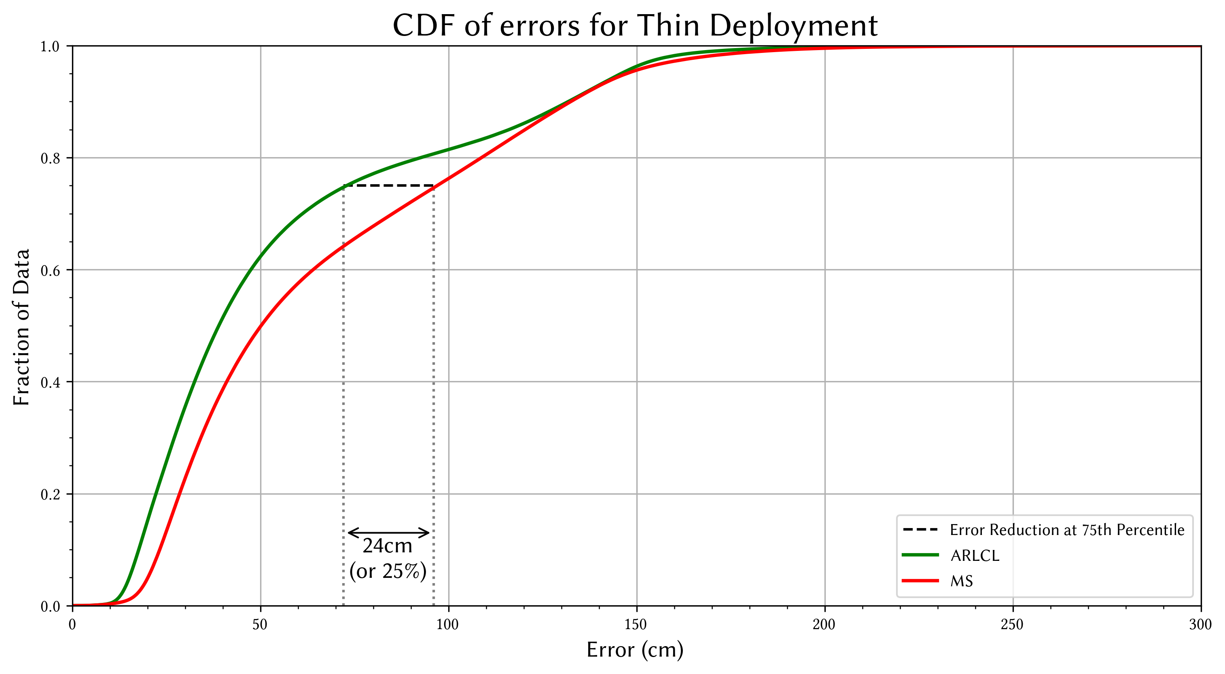
Cumulative distribution function of the positioning errors
Anchor-free Ranging-Likelihood-based Cooperative Localization
Results

Slide 15
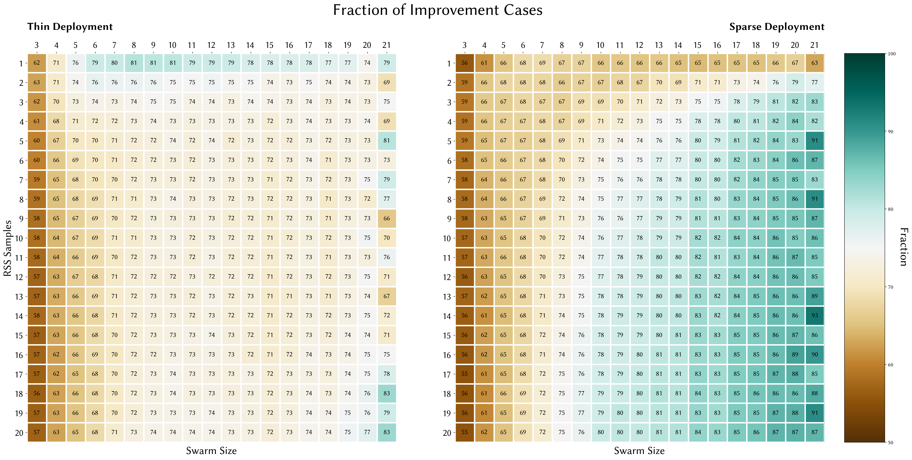
Fraction of improved cases
Anchor-free Ranging-Likelihood-based Cooperative Localization
Results

Slide 16
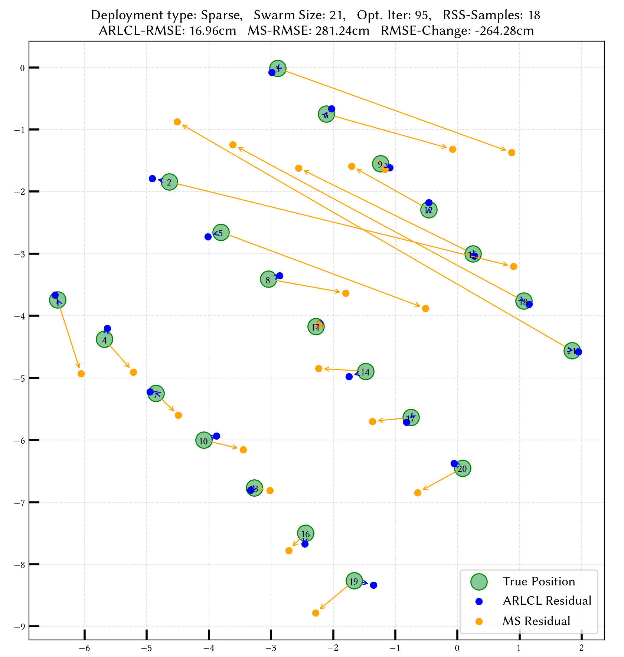
Estimation residuals and trajectories (best ARLCL win for Size:21)
Anchor-free Ranging-Likelihood-based Cooperative Localization
Results

Slide 17
Conclusions
Anchor-free Ranging-Likelihood-based Cooperative Localization
Results
Positioning error for both ARLCL and MS is correlated to both Swarm Size and Sample Size
Sparse deployments are more prone to signal noise
Bellow 85th percentile, ARLCL introduces an overall improvement (same performance above that)
ARLCL’s gain is also correlated to both Swarm Size and Sample Size
ARLCL’s gain depends also on the Swarm Shape (more gain at Thin/Dense scenarios)

Slide 18
Future work
Anchor-free Ranging-Likelihood-based Cooperative Localization
Results
Assess more swarm deployment scenarios
(of different densities/shapes/with in-between obstacles/etc.)
Assess common ranging models under different environments
Assess other ranging technologies (UWB/WiFi)
Fuse other types of signals into the localization process (Inertial data)
Take it from offline to online positioning

Slide 19
Thank you for your time!
Dimitris Xenakis
dimitrios.xenakis@inf.unibe.ch

Slide 20
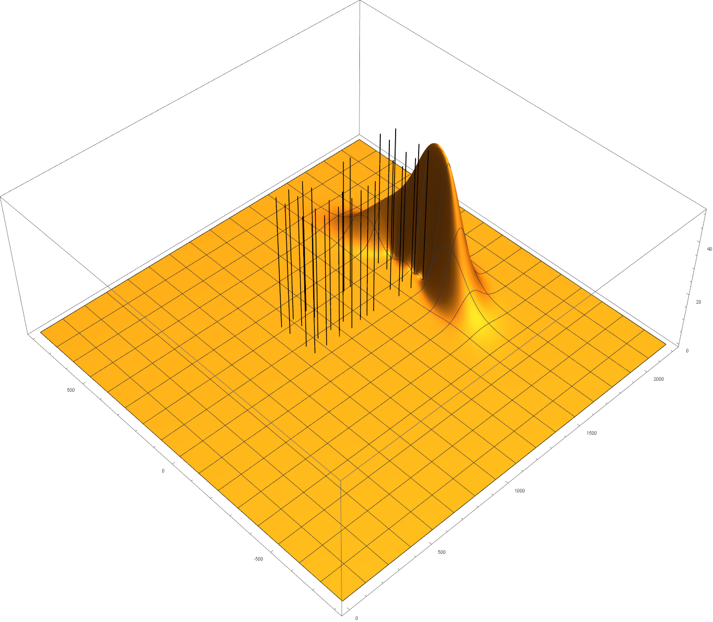
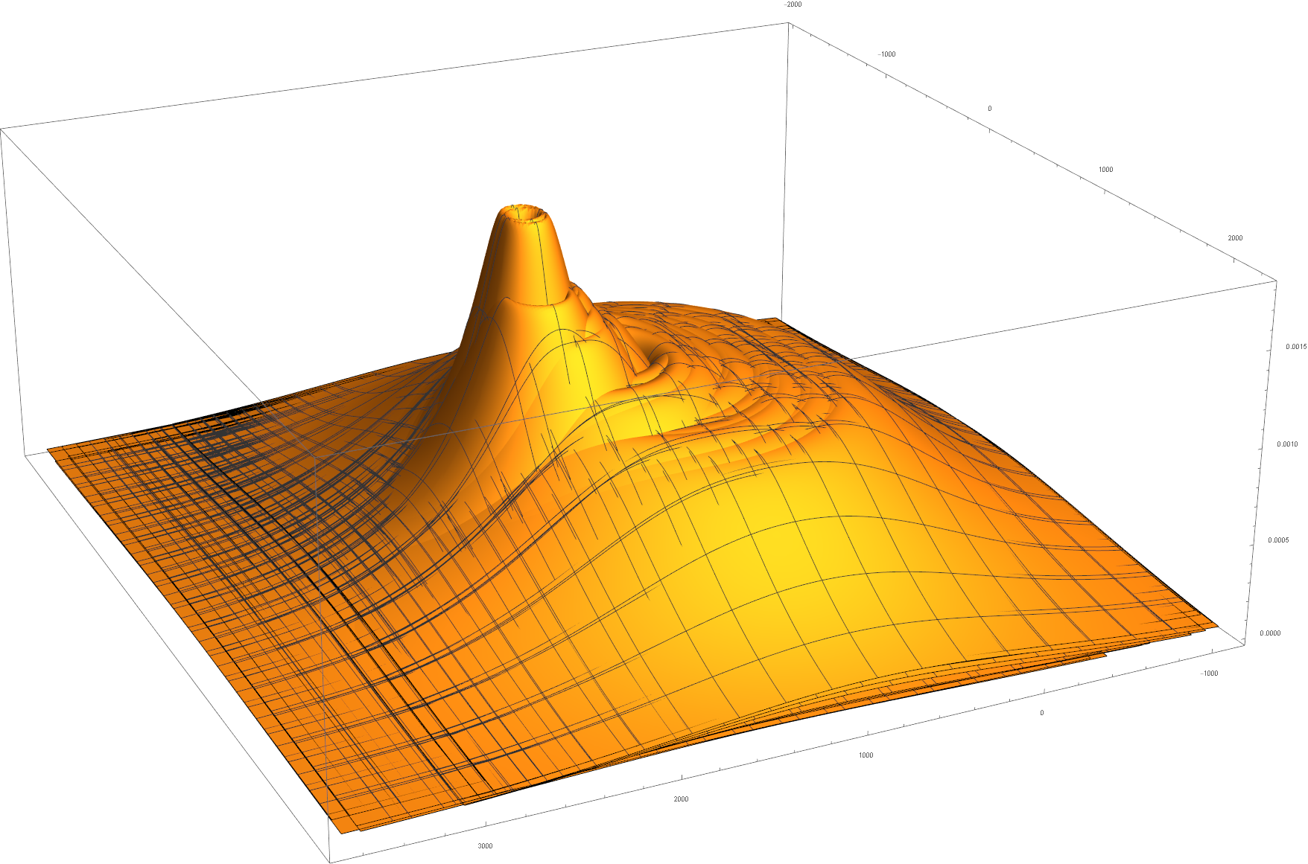
Anchor-free Ranging-Likelihood-based Cooperative Localization
Performing swarm positioning with ARLCL
Likelihood Optimization
N effective Neighbors → N such functions
(Find where Global Max is)
Multiply
Optimize
Machine precision problems!
Can use Logarithms

